Slide 1
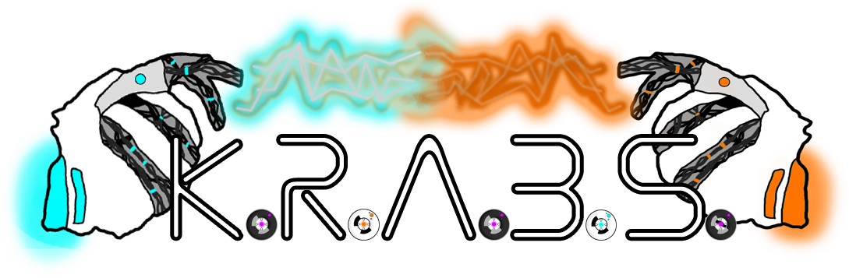
Group 8 – Gold Pitch
Design Masterclass – Bandai Namco Brief
Max Carter & Rebecca Brannum

Slide 2


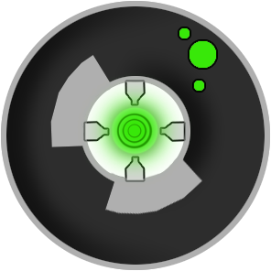

What is K.R.A.B.S?
Game we created for Ludum Dare 38
2D, 2 player, single screen
Simultaneous, symmetrical play
Resource gathering and battling
Notes:
Single screen 2 players 2D Simultaneous, symmetrical play Resource gathering + battling Currently just 1 level

Slide 3
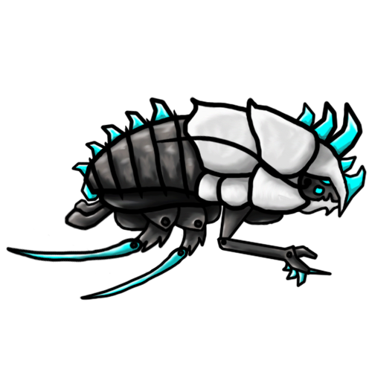
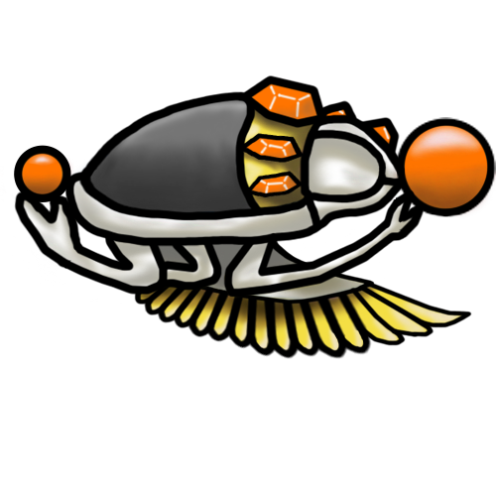
What’s Changed?
New maps
New characters
New game mode
Control & UI iterations
Menu iterations
Bug fixes

Slide 4
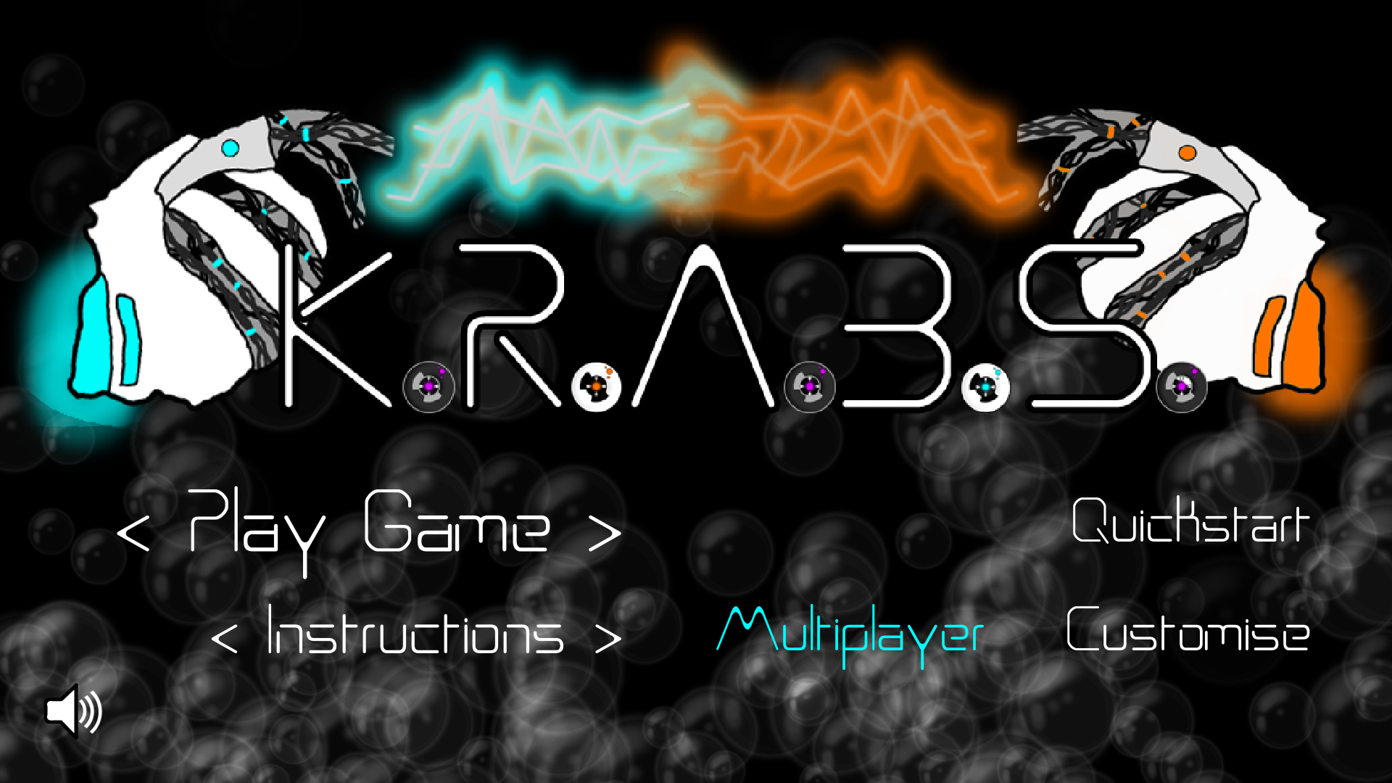
Gameplay
Notes:
Add additional characters to choose from Animations for characters Stage selection Tournament mode Main menu (options)

Slide 5
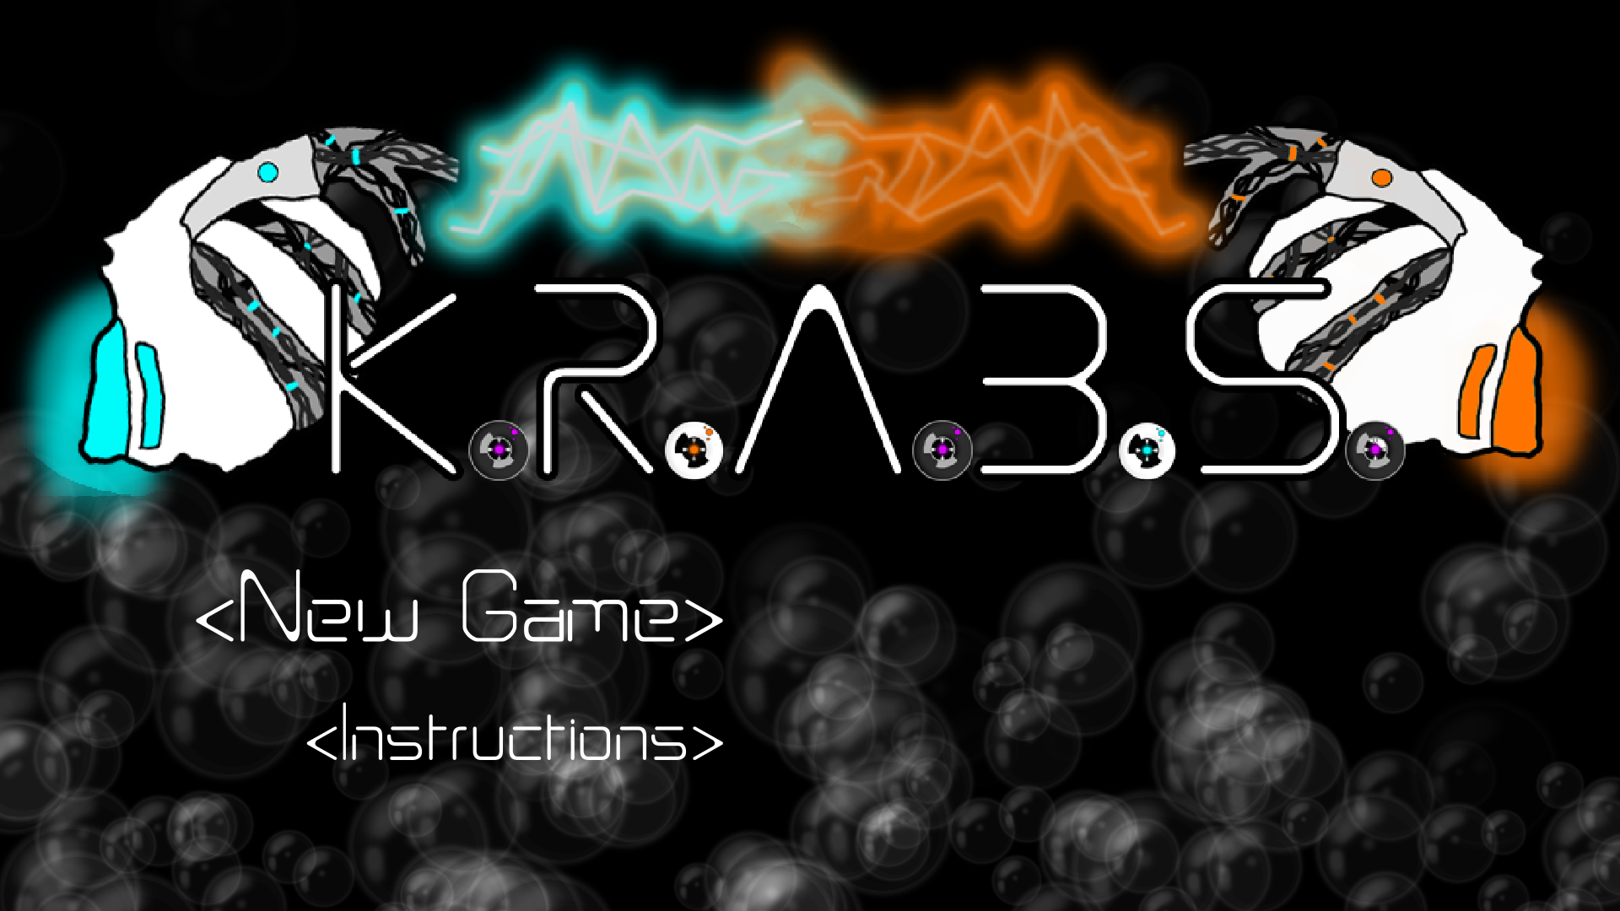
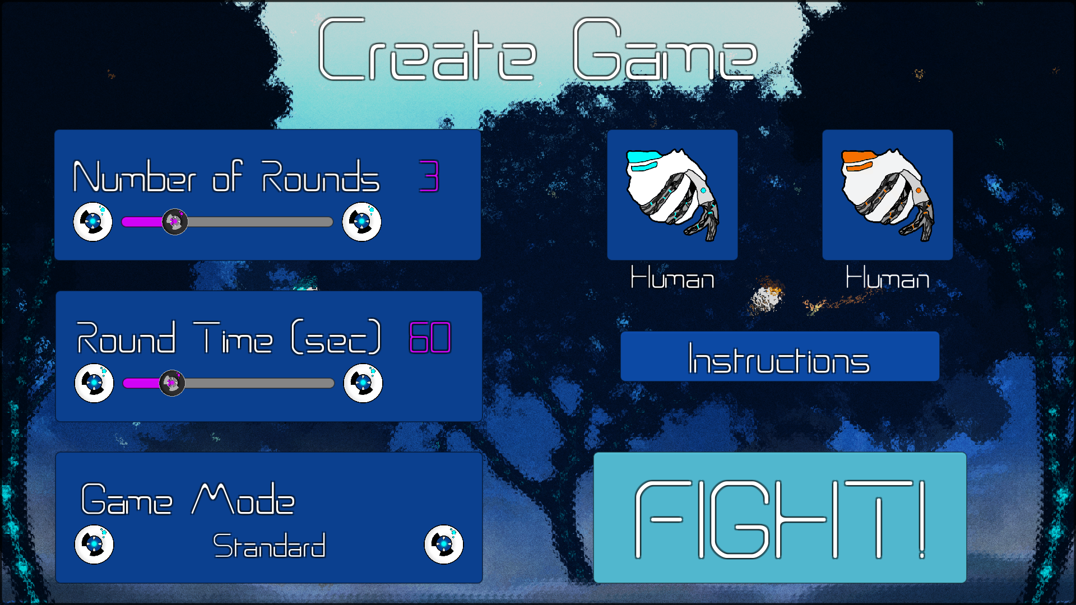
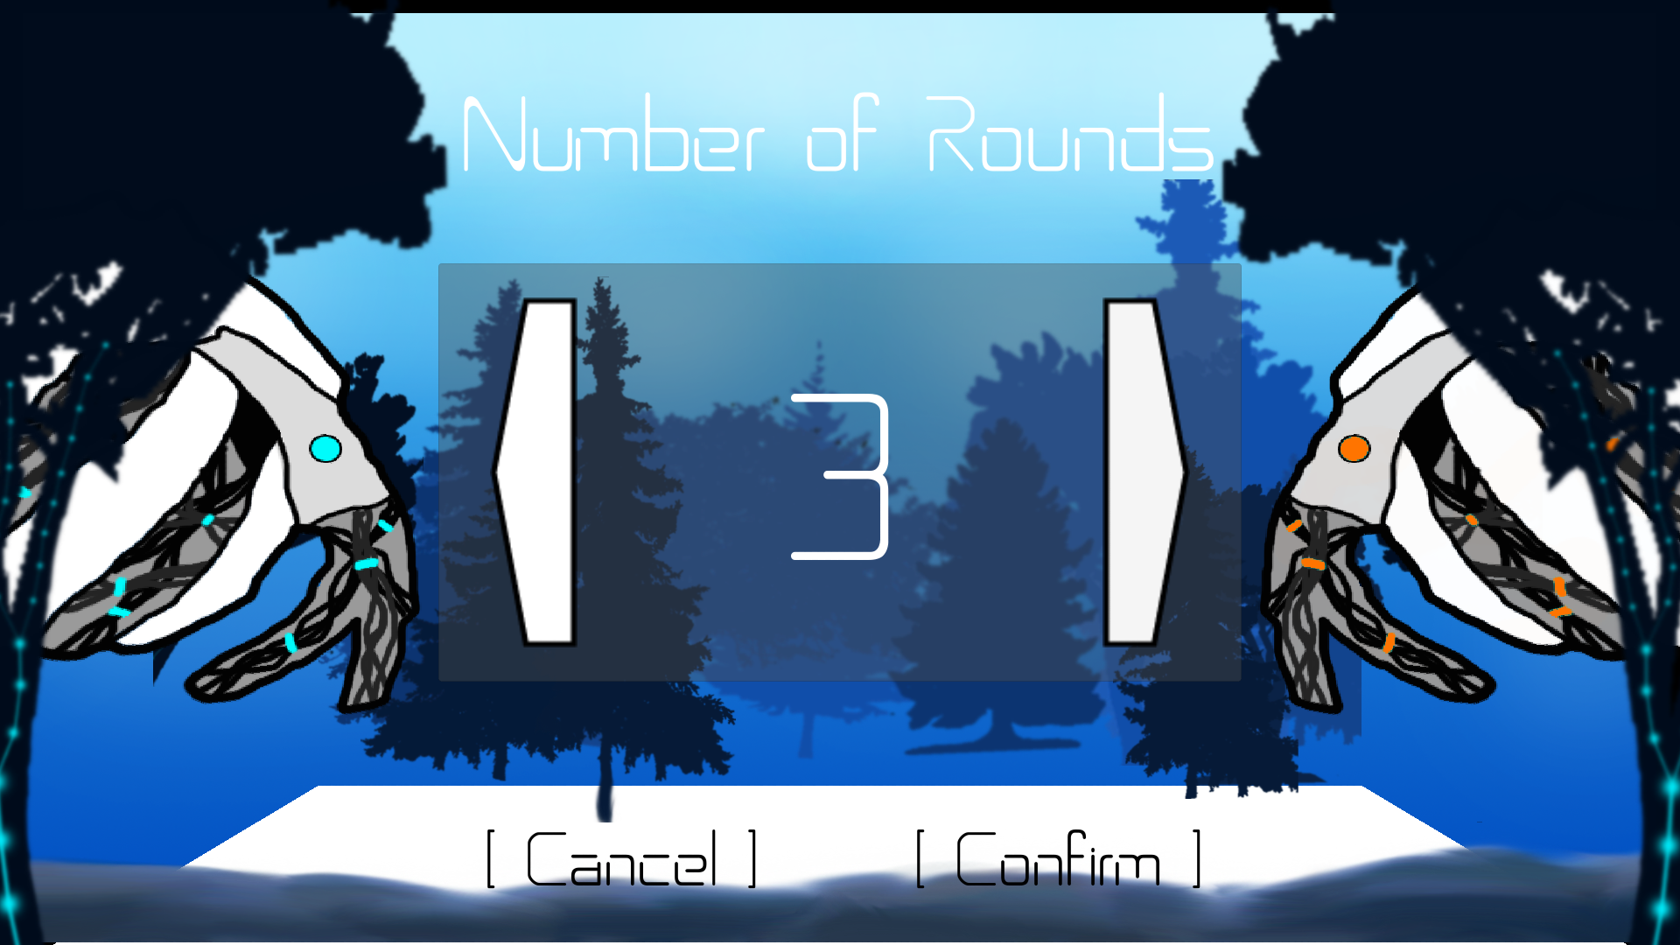
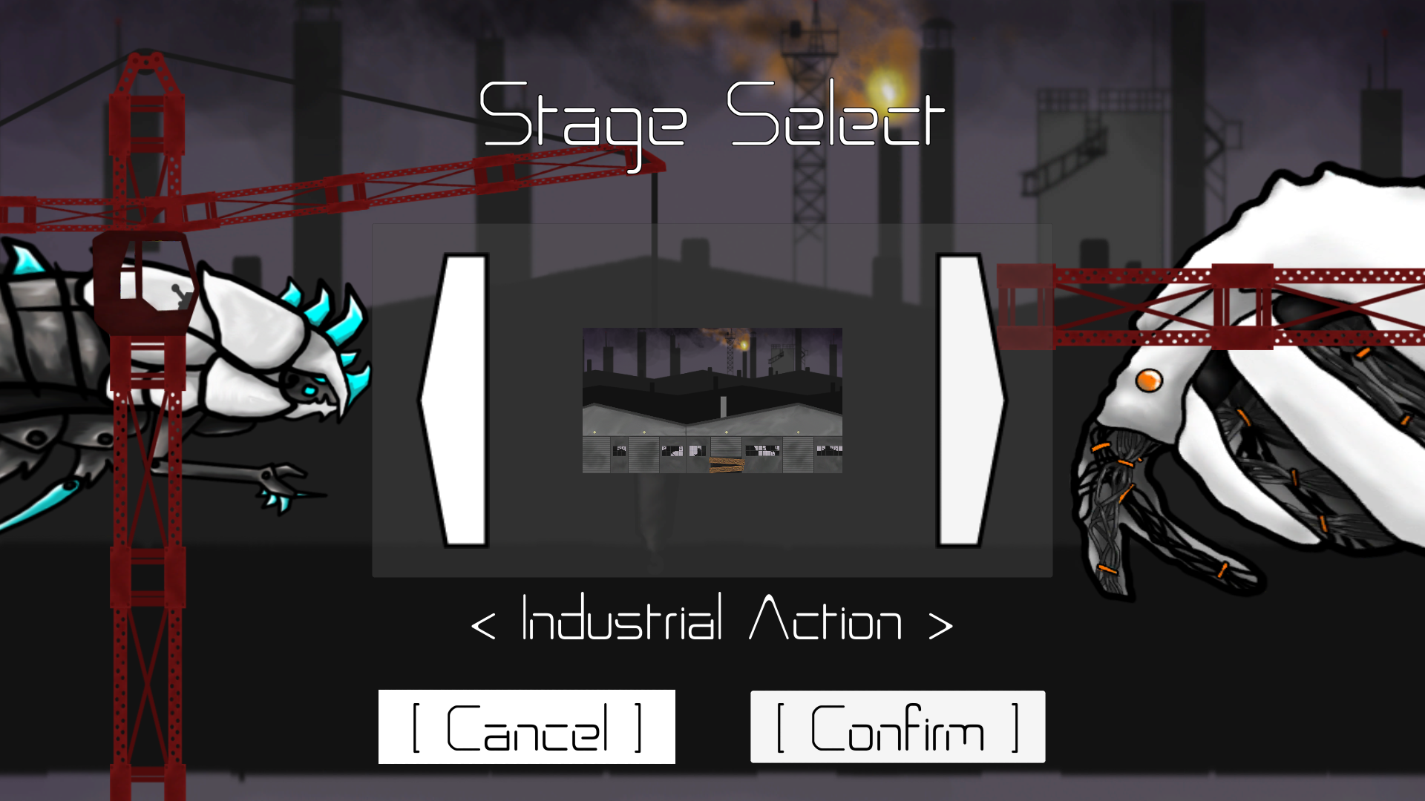
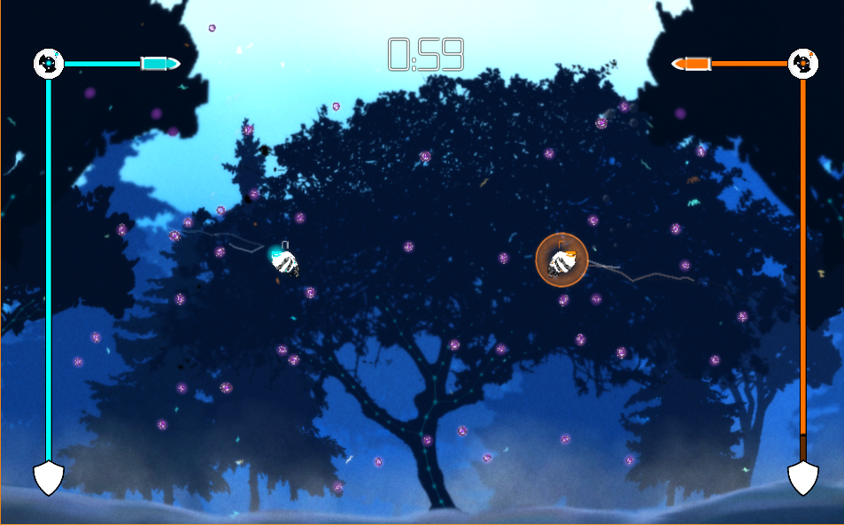
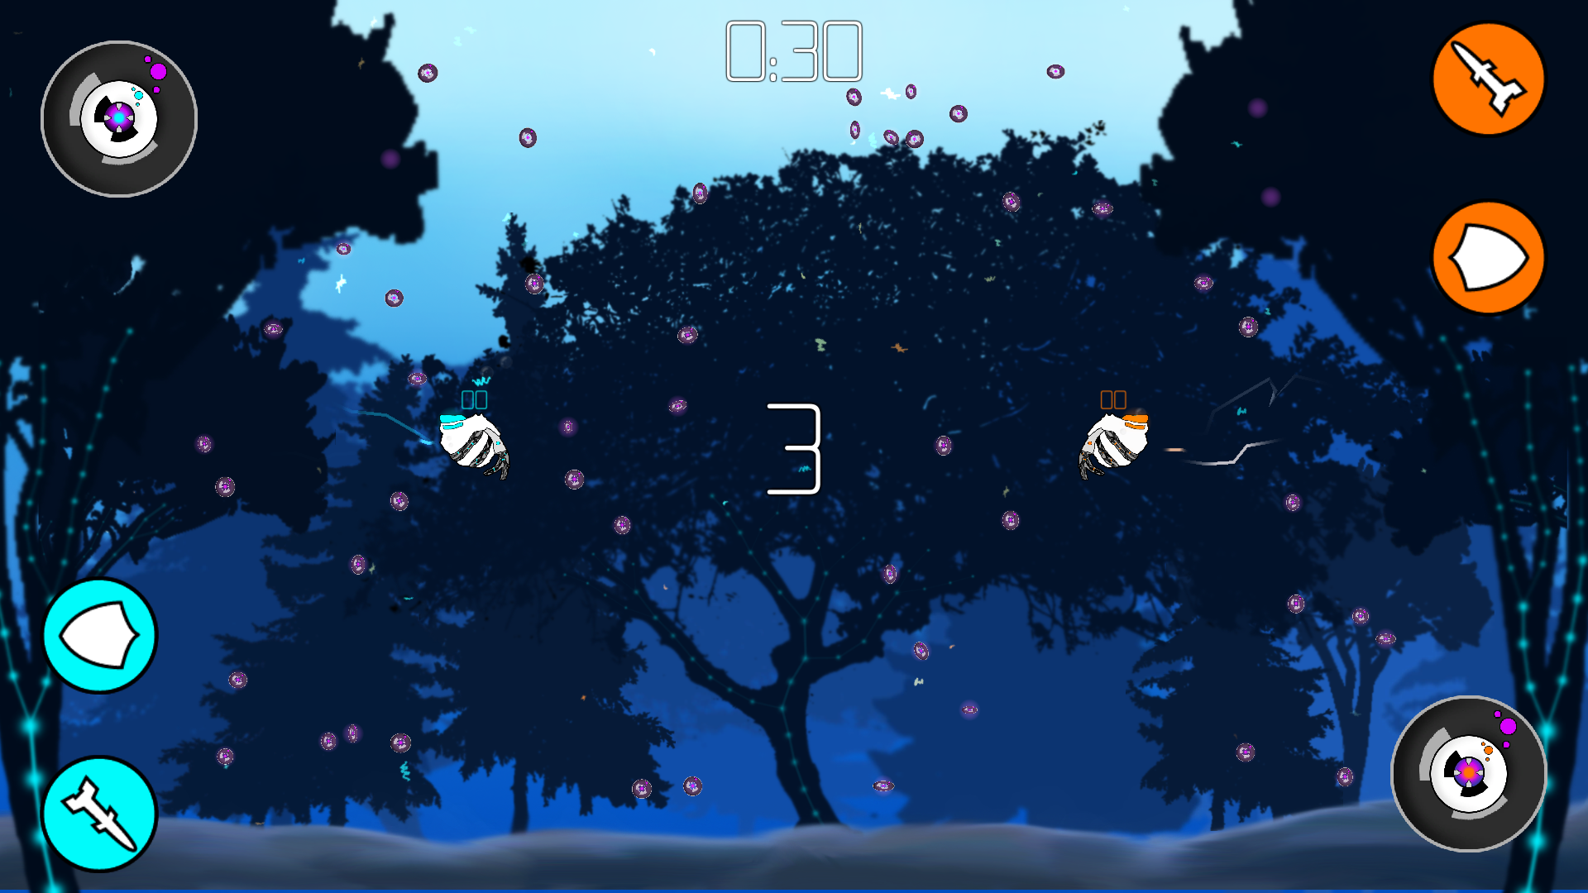
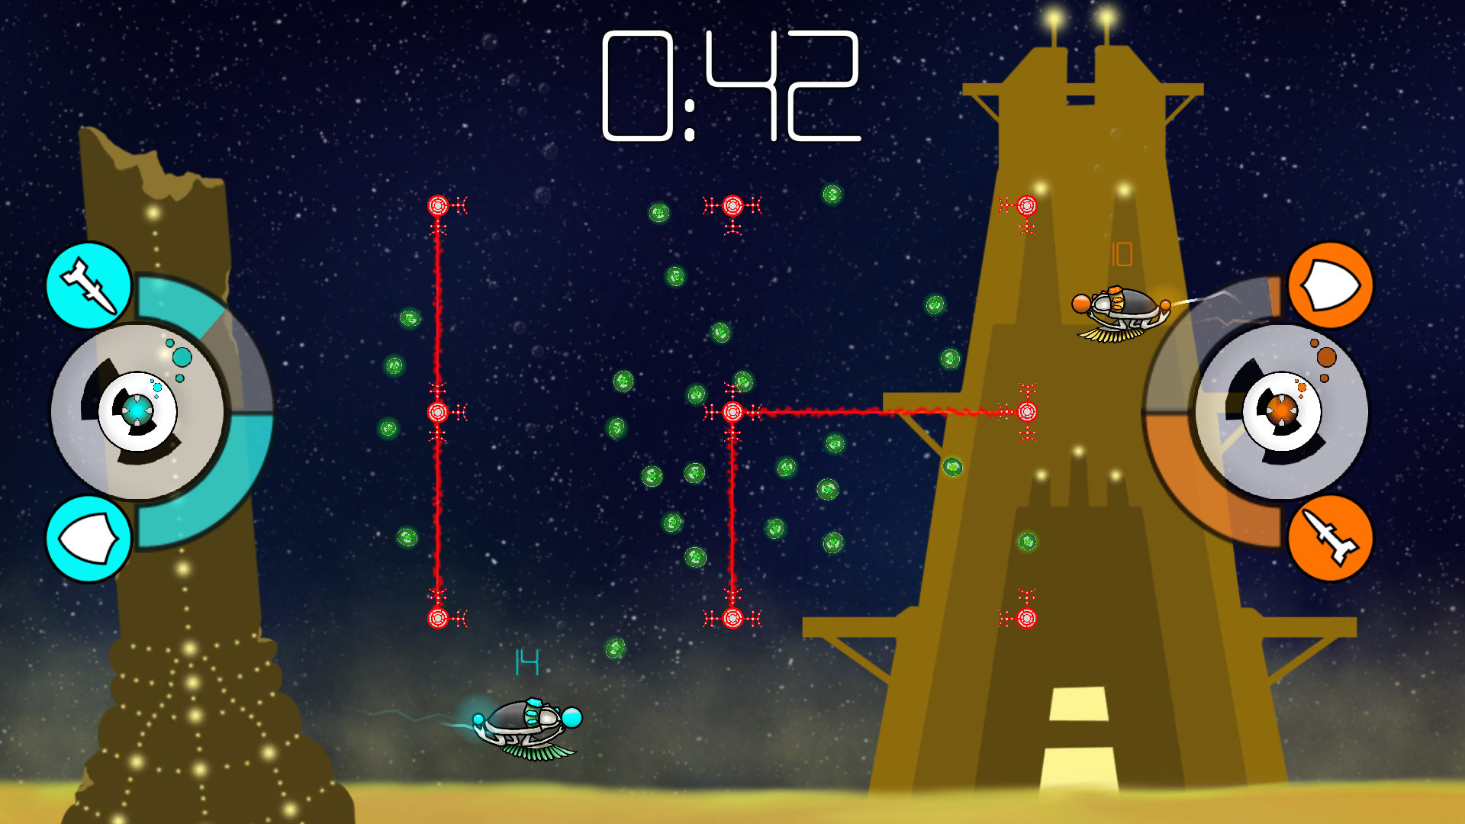
UI Iterations

Slide 6
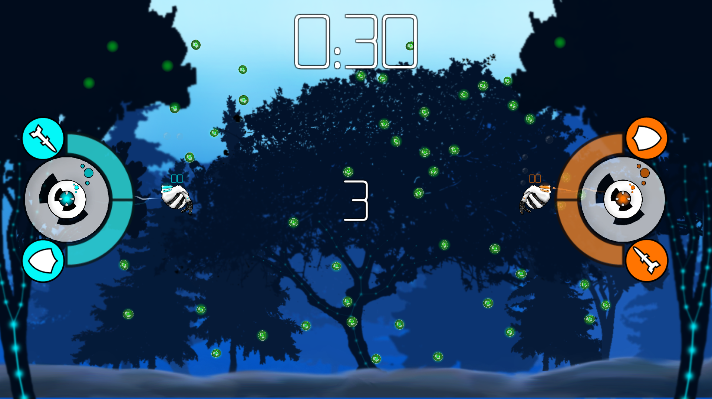
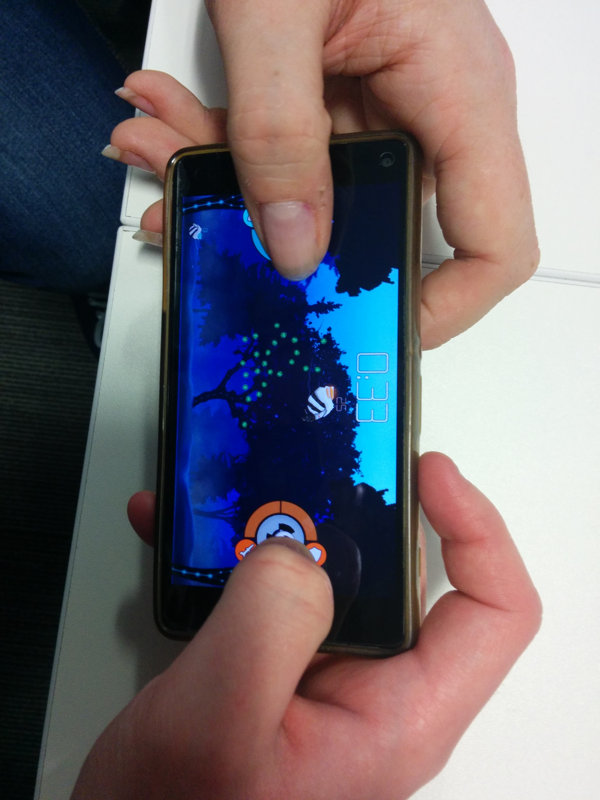
Control Iterations

Slide 7

Playtesting Feedback
“Gameplay was intuitive and the controls made sense”
“Mechanics were fun and well-balanced”
“We enjoyed the constant back and forth”
“User interface was easy to navigate”
“Visuals have a nice distinct style, easy to distinguish between
foreground and background.”
“Wasn’t initially clear what the controls were, but quickly figured it out”
“Didn’t enjoy the tactile feeling of dragging fingers along the screen”

Slide 8
Questions?

